Slide 1
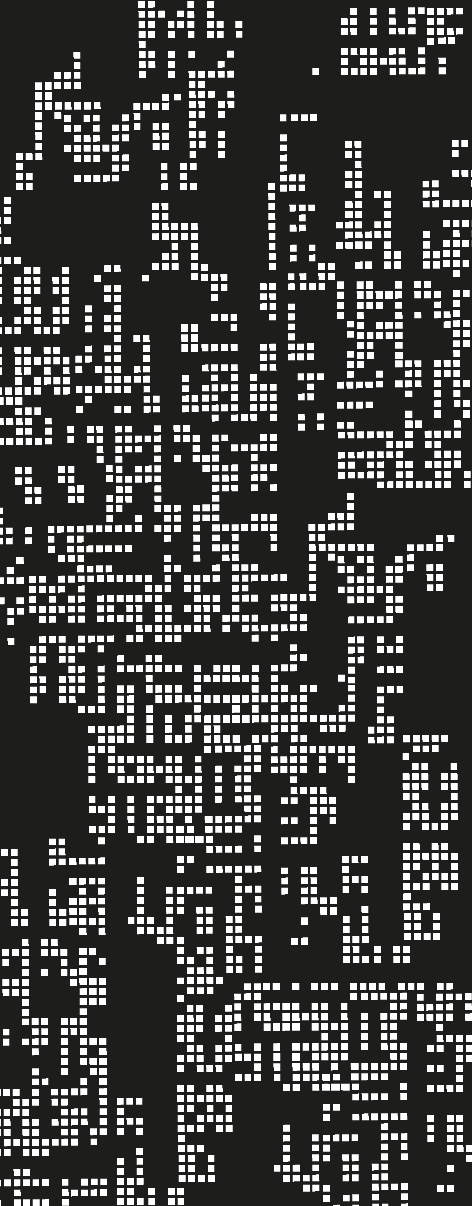
Basics
1. Introduction to Racket and Scheme

Slide 2
Last class…
What is a paradigm?
How does it influence the style of programming? What concepts it stands for?
What is a programming language?
What is the difference between syntax and semantics?

Slide 3
Contents
01
Racket’s characteristics
02
DrRacket
03
Basic Elements
04
Data Structures

Slide 4
What is an expression?
What is an evaluation?
What is a value?
An entity that can be evaluated to obtain a value, therefore:
Reduce, simplify an expression to obtain a value.
Depends on the design, could be primitives, objects (OOP), functions(FP), etc

Slide 5

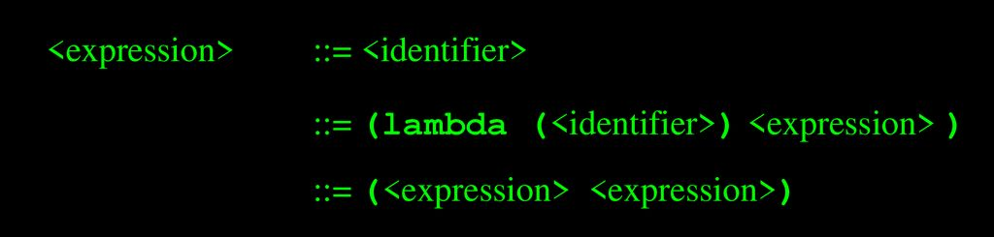
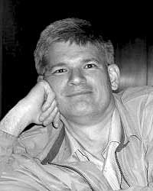
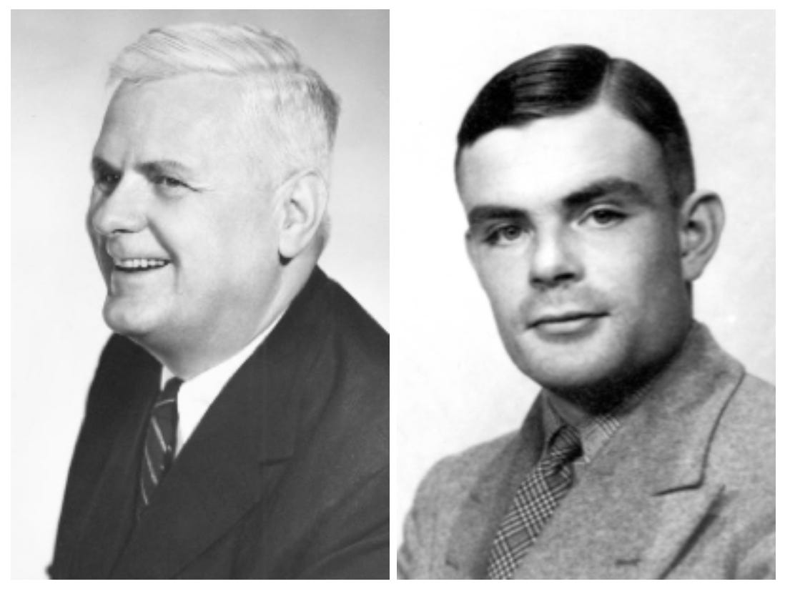
Scheme
Lambda calculus

Slide 6
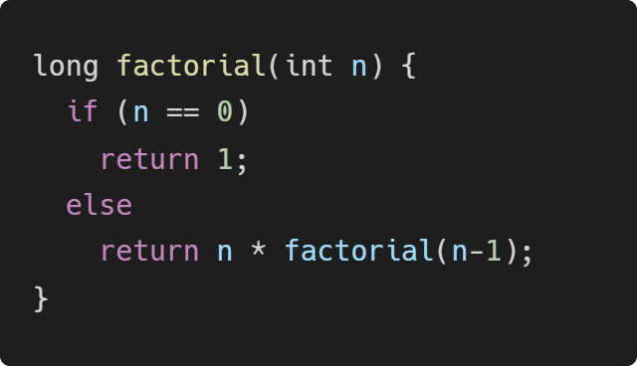
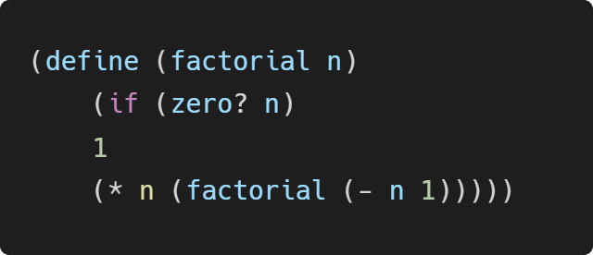
Racket’s characteristics
Functional style
Imperative style

Slide 7
Racket’s characteristics
Functional style
Imperative style
Built around the evaluation of expressions and the application of functions (on immutable data)
Closer to expressing what to compute
Closer to mathematics
Built around the execution of sequences of commands for their effects on mutable storage
Closer to expressing how to compute
Closer to computer hardware

Slide 8

Dr Racket

Slide 9
Basic elements - Primitives
Primitives | Examples and Observations
Numbers | -1.3 | 6.02e+23 | 1+2i | 4/3
Booleans | #t | #f | (and 2 3) | (or 1 #f)
Strings | “Hola mundo” | “Hola \” mundo” | “” | "λx:(μα.α→α).xx"
Symbols | ‘hola

Slide 10
Basic elements - Primitives
Primitives | Examples and Observations
Numbers | -1.3 | 6.02e+23 | 1+2i | 4/3
Booleans | #t | #f | (and 2 3) | (or 1 #f)
Strings | “Hola mundo” | “Hola \” mundo” | “” | "λx:(μα.α→α).xx"
Symbols | ‘hola

Slide 11
Basic elements - Functions
Scheme uses prefix syntax with parentheses (which means parentheses are important!)
( function arg1 … argN )
There are different predefined functions, for mathematics, logic, strings or printing.
And something important: It is a safe language, we have no segmentation faults!
Scheme is also not statically typed

Slide 12
Basic elements - Conditionals, Identifiers and Functions
Write as clear as possible for nested cases :)
Locally introduce two identifiers associated with numbers and return the maximum.
Define a function to add two parameters
Define a function that receives two parameters and returns randomly one of them (you may use random function)

Slide 13
Data Structures - Pairs + Lists
Define a function that receives a pair of numbers and returns a new pair where the elements are incremented by 1.
Define a function that receives a list and returns randomly one of the elements inside the list (you may use (random k) function)

Slide 14
Data Structures - Vectors
Define a function that receives a vector and changes randomly one of their elements to a fixed value.

Slide 15
Summary
Prefix notation
Standard primitive and compound data types
Difference between mutable and immutable data structures
Secure access to list and vectors

Slide 16
On next class
Functions
Induction and Recursion

Slide 17
References
PrePLAI, sections 1 and 2.
Racket Guide
Racket Reference

